Slide 1
MODULE 5
Sequence Modelling

Slide 2
Introduction to Sequence Modeling and Unfolding Computational Graphs

Slide 3
Learning Outcomes
By the end of this session,
Define sequence modeling
Explain a computational graph
Describe recurrent computation
Unfold a computational graph over time
Identify the advantages of unfolding

Slide 4
Sequence Data
Data where order matters.
Examples:
Text: “Students learn deep learning.”
Speech: audio samples over time
Video: sequence of frames
Sensor data: temperature, ECG, accelerometer readings
Financial data: daily stock prices

Slide 5
Limitation of Feedforward Networks
A feedforward network:
Assumes inputs are independent
Usually requires fixed-size input
Does not naturally remember previous inputs

Slide 6
Need for Sequence Models
We need a model that can:
Accept variable-length sequences
Preserve order
Remember previous information
Share knowledge across time steps

Slide 7
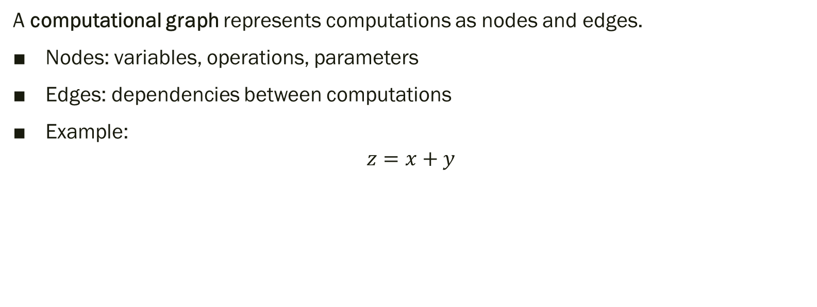
Computational Graph
A computational graph represents computations as nodes and edges.
Nodes: variables, operations, parameters
Edges: dependencies between computations
Example:
$$z=x+y$$
x ──┐
├──► z
y ──┘

Slide 8
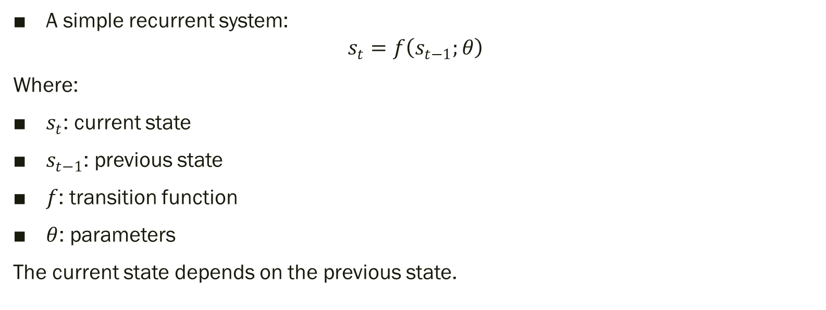
Dynamical System
A simple recurrent system:
$$s_{t}=f\left(s_{t−1} ; θ\right)$$
Where:
$s_{t}$: current state
$s_{t−1}$: previous state
$f$: transition function
$θ$: parameters
The current state depends on the previous state.

Slide 9
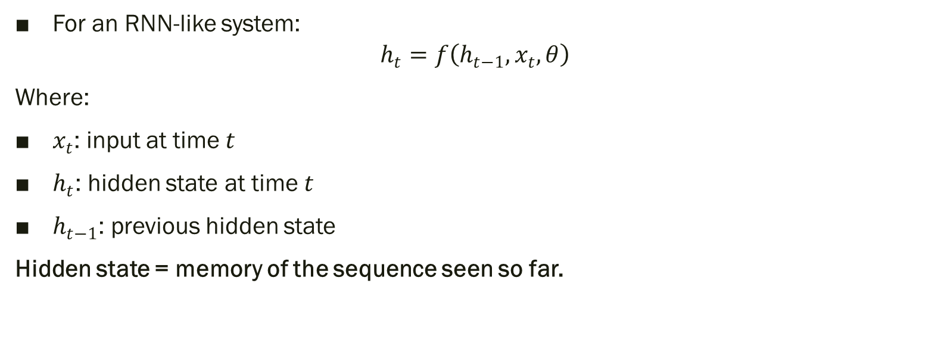
Adding Input
For an RNN-like system:
$$h_{t}=f\left(h_{t−1} , x_{t} , θ\right)$$
Where:
$x_{t}$: input at time $t$
$h_{t}$: hidden state at time $t$
$h_{t−1}$: previous hidden state
Hidden state = memory of the sequence seen so far.

Slide 10
Recurrent Computational Graph
┌──────────
│ ▼
x1 → [ h1 ] → [ h2 ] → [ h3 ] → ...
The loop indicates that information from earlier time steps influences later states.

Slide 11
What Is Unfolding?
Unfolding means expanding the recurrent computation over time.
It converts a cyclic graph into a repeated chain:
x1 → h1 → h2 → h3
│ │ │
f f f
θ θ θ

Slide 12
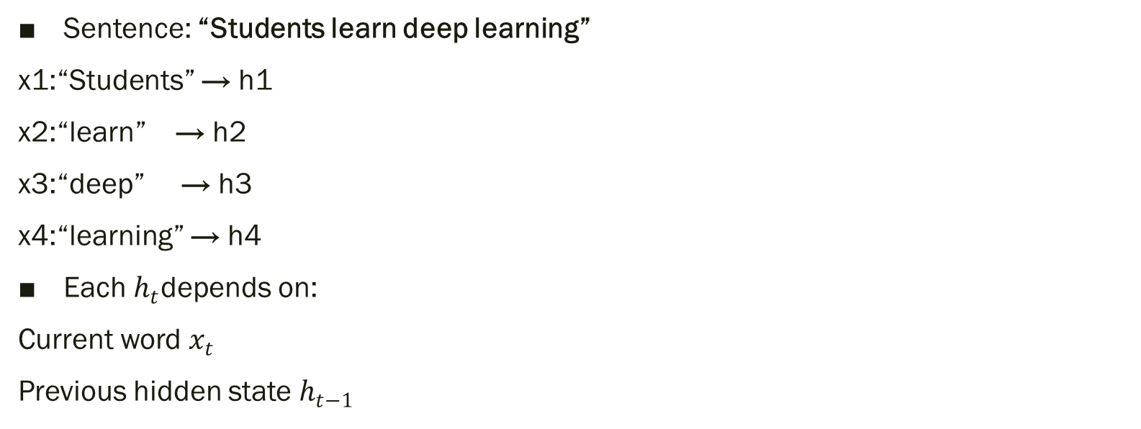
Unfolded Graph Example
Sentence: “Students learn deep learning”
x1:“Students” → h1
x2:“learn” → h2
x3:“deep” → h3
x4:“learning” → h4
Each $h_{t}$depends on:
Current word $x_{t}$
Previous hidden state $h_{t−1}$

Slide 13
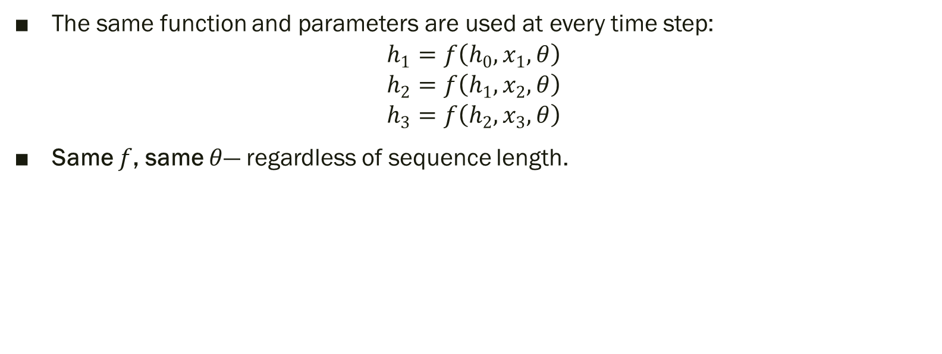
Key Property — Parameter Sharing
The same function and parameters are used at every time step:
$$h_{1}=f\left(h_{0} , x_{1} , θ\right)$$
$$h_{2}=f\left(h_{1} , x_{2} , θ\right)$$
$$h_{3}=f\left(h_{2} , x_{3} , θ\right)$$
Same $f$, same $θ$— regardless of sequence length.

Slide 14
Advantages of Unfolding
Handles variable-length sequences
Uses the same transition function at every step
Requires fewer parameters
Provides a compact model representation
Clearly shows information flow across time
Enables backpropagation through time

Slide 15
Recurrent vs Feedforward
Aspect | Feedforward Network | Recurrent Network
Input structure | Fixed-size input | Variable-length sequence
Order sensitivity | Limited | Order matters
Memory | No internal sequence memory | Hidden state carries context
Parameter sharing | Across layers | Across time steps
Example task | Image classification | Language modeling, speech recognition

Slide 16
RECURRENT NEURAL NETWORK
Learn patterns in sequential data by maintaining a hidden state that carries information from previous time steps
Basic architecture
Input → Hidden state → Output
The hidden state is also passed to the next time step, allowing the network to use previous context.

Slide 17
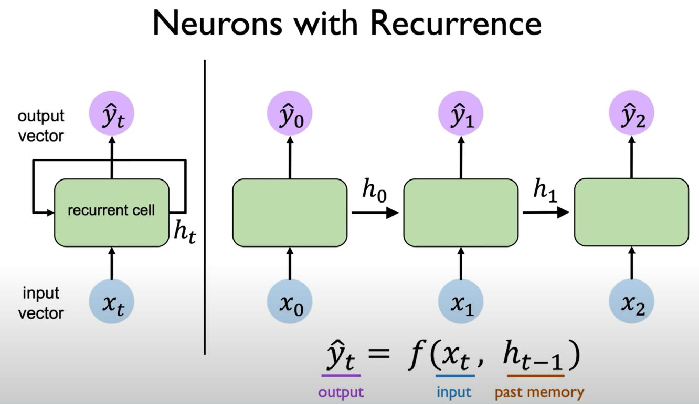

Slide 18
Consider the input sequence: “I — love — AI.”
At time(t=1), the network processes “I”.
At time(t=2), it processes “love” using the previous hidden state.
At time(t=3), it processes “AI” using information from earlier steps.
The same recurrent computation and weights are reused at each time step.

Slide 19
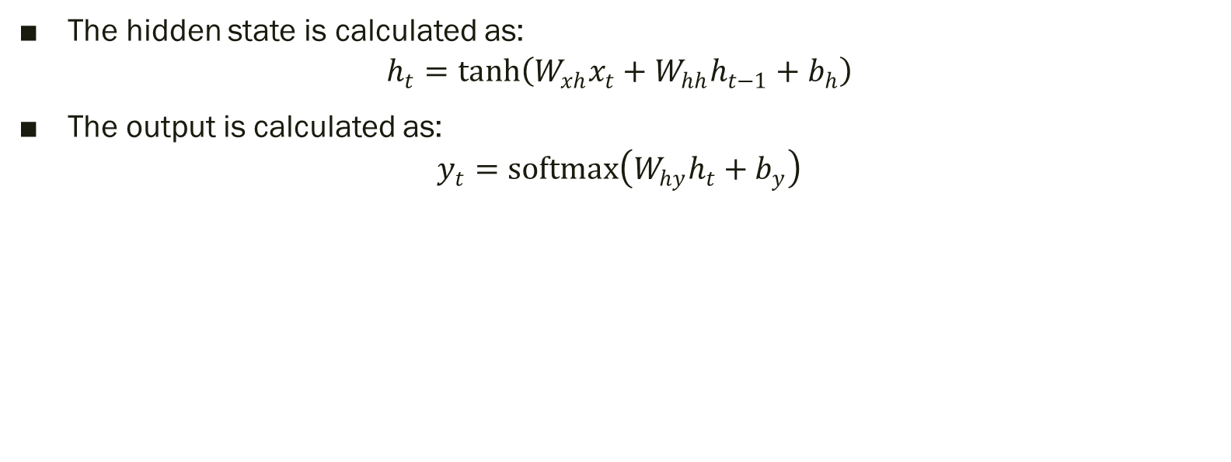
MATHEMATICAL EQUATION
The hidden state is calculated as:
$$h_{t}=tanh⁡\left(W_{xh}x_{t}+W_{hh}h_{t−1}+b_{h}\right)$$
The output is calculated as:
$$y_{t}=softmax⁡\left(W_{hy}h_{t}+b_{y}\right)$$

Slide 20
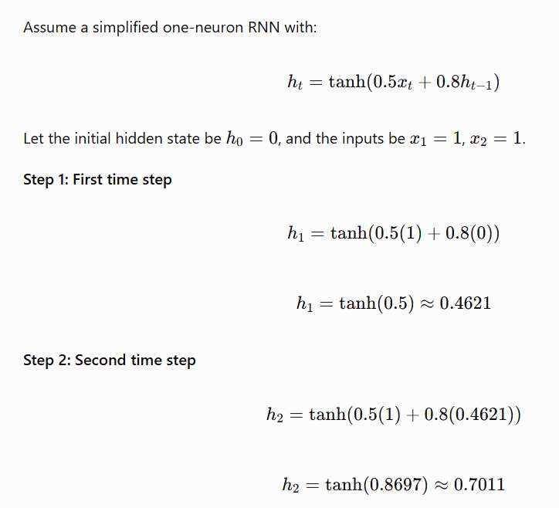
Simple Numerical
Observe the result
First hidden state:0.4621
Second hidden state:0.7011
The second state depends on both the current input and the previous hidden state.

Slide 21
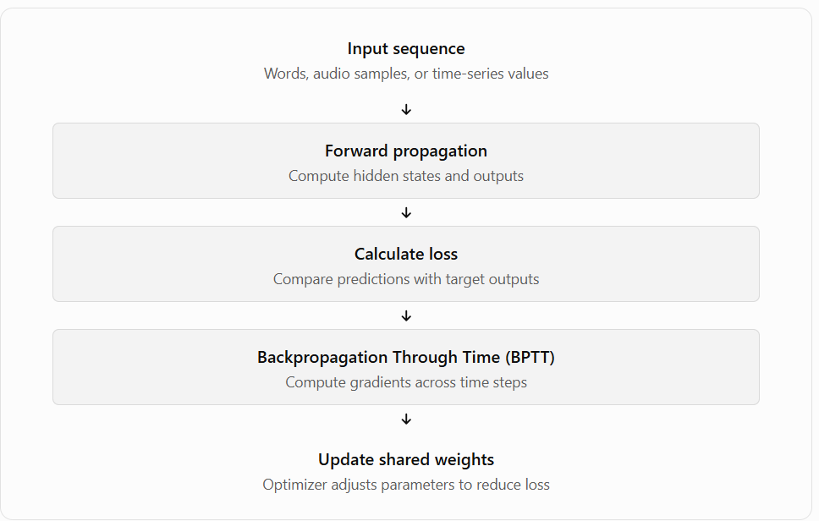
How does RNN LEARN?

Slide 22

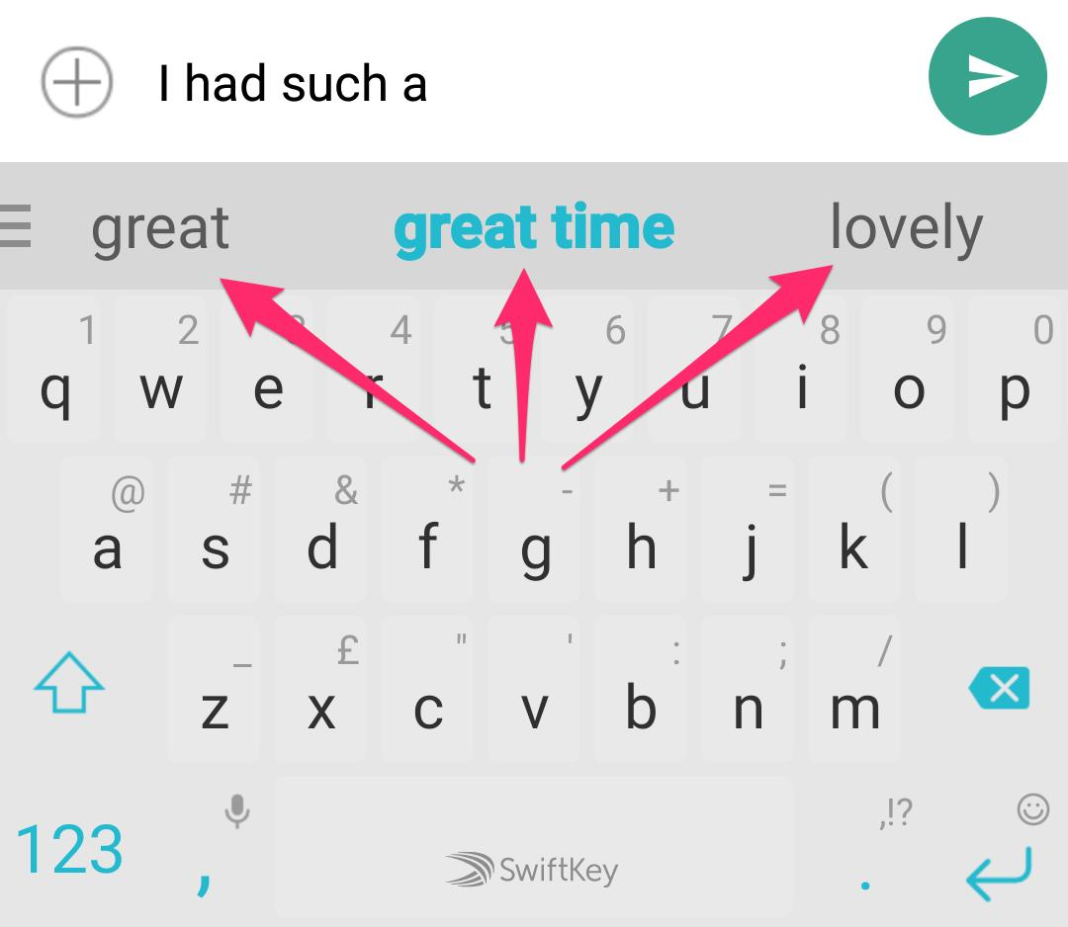
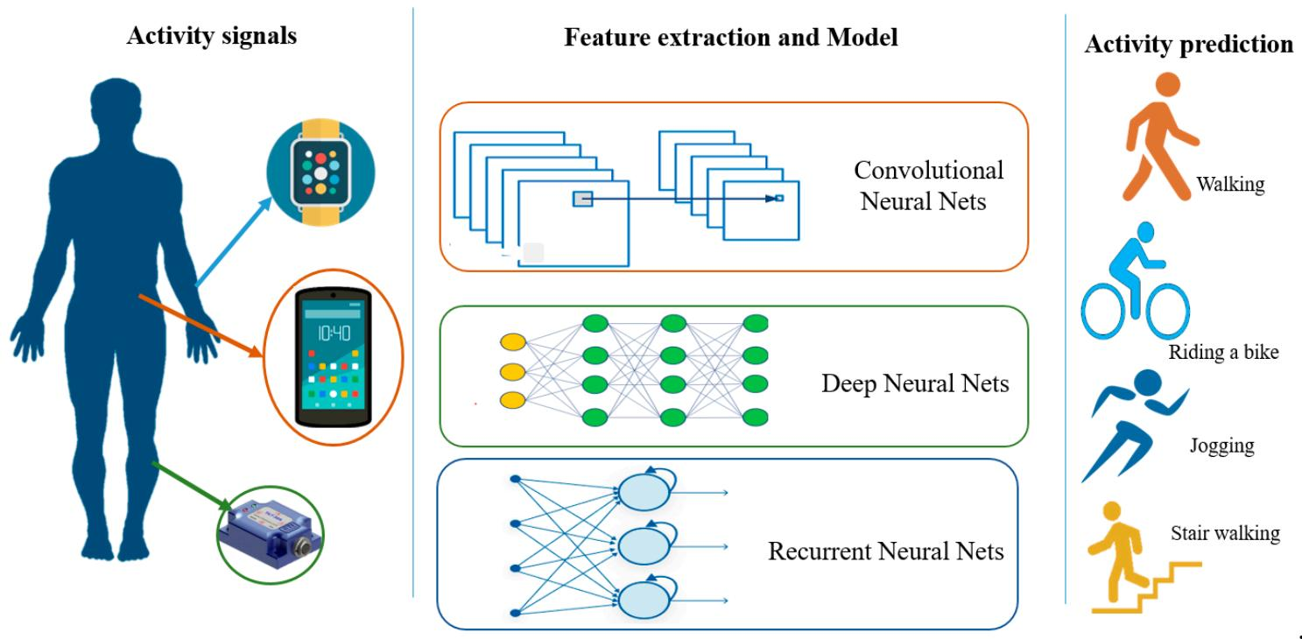
Real Applications:

Slide 23
TYPES OF INPUT-OUTPUT RNN TRANSITIONS
One-to-One One question, one answer.
One-to-Many One photograph, a complete caption.
Many-to-One Many words, one sentiment label.
Many-to-Many Every word receives a label
Encoder–Decoder One sentence is transformed into another sentence.

Slide 24
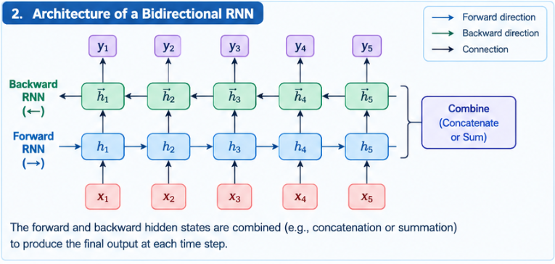
BIDIRECTIONAL RNN

Slide 25
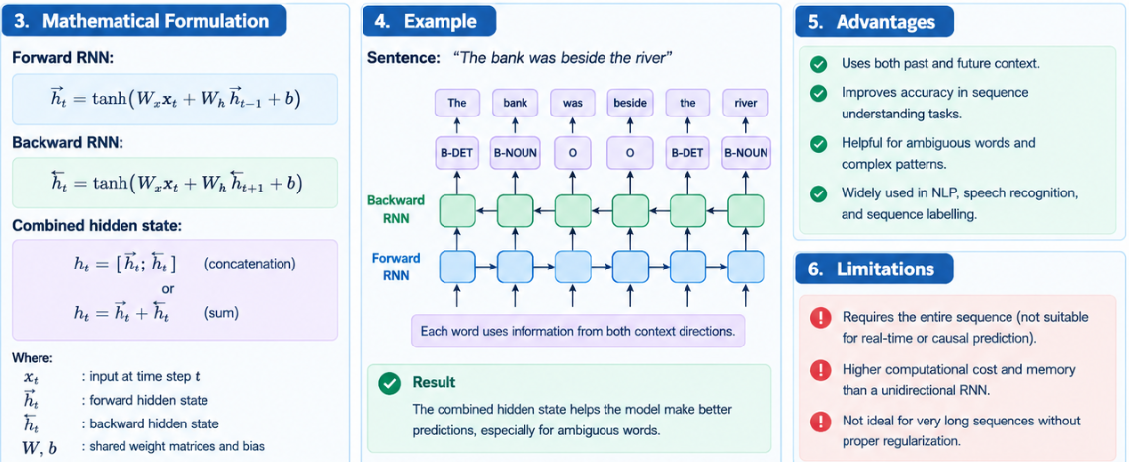

Slide 26
EXAMPLE:
“The bank was beside the river.”
A sequence-labelling model processes every word and predicts a label for it.
The word “bank” can use the context on both sides, especially “beside the river,” to infer the riverbank meaning.
This is useful in named-entity recognition, part-of-speech tagging, and other language-understanding tasks.
“I went to the bank to deposit money.”
“How do you know that bank refers to a financial institution and not the side of a river?”
RNN is unsuitable for strictly causal predictions when future observations are unavailable.

Slide 27
Encoder–Decoder Sequence-to-Sequence Architectures
Architecture:
Encoder: Reads the input sequence one element at a time and produces hidden representations.
Context representation: Summarizes information from the input for the decoder. In a basic model, this may be the encoder's final hidden state.
Decoder: Uses the encoded information and previously generated tokens to produce the output sequence step by step.

Slide 28
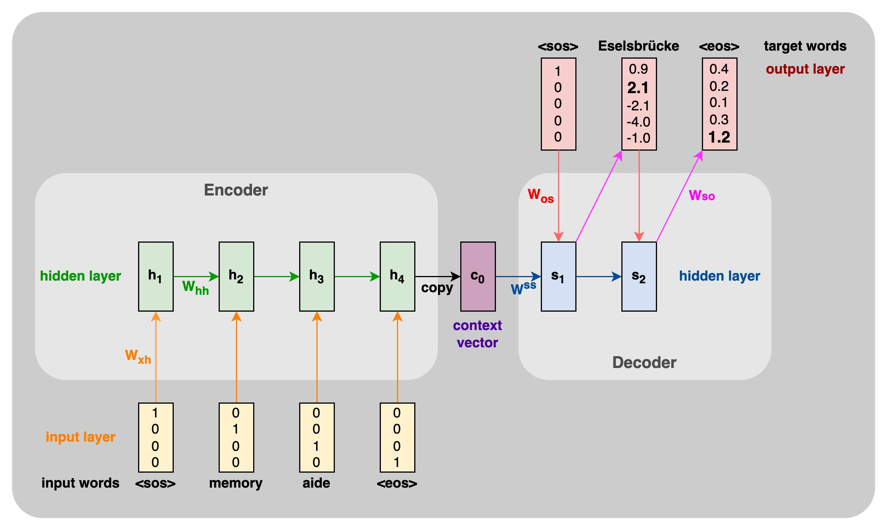
Equation
Encoder:
h_{t}=f(h_{{t-1},}x_{t})
Decoder:
s_{t}=f(s_{{t-1},}y_{{t-1},}c)

Slide 29

DEEP RECURRENT NETWORKS
A deep recurrent network has multiple recurrent layers stacked on top of one another.
First layer: Learns basic sequential patterns.
Intermediate layers: Learn more complex representations.
Final layer: Produces features for prediction or classification.

Slide 30
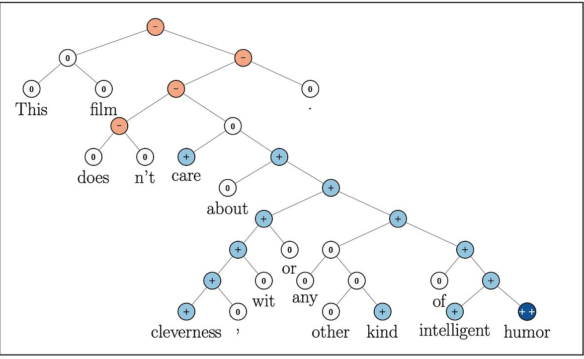
Recursive Neural Networks
Recursive network can combine word or phrase representations according to a tree structure

Slide 31
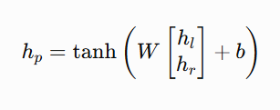
How it works
Represent individual words as vectors.
Combine the vectors of child nodes using a learned function.
Produce a parent-node representation.
Continue combining representations until reaching the root.
Use the root representation for tasks such as sentiment classification.
A simple binary composition function is:

Slide 32
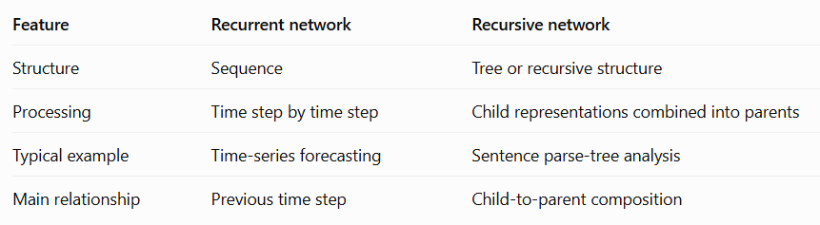
Recurrent vs. Recursive Neural Networks

Slide 33
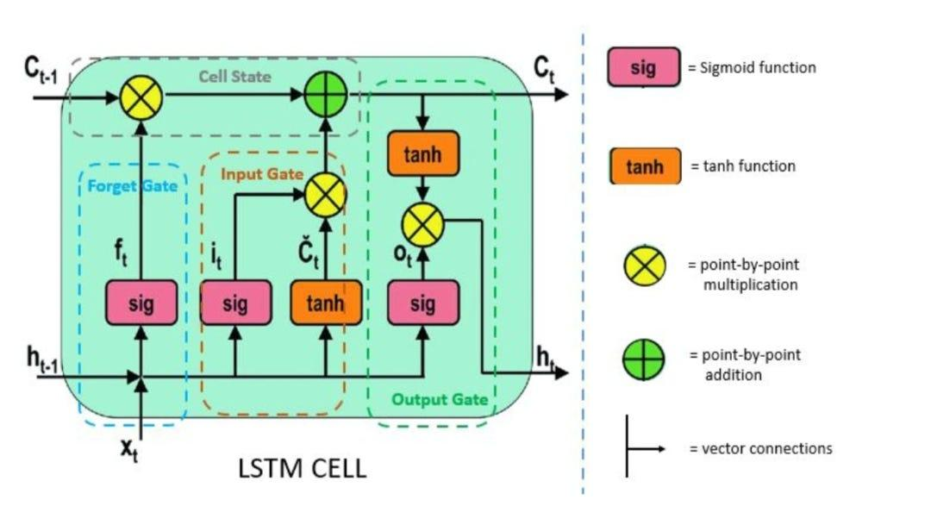
LSTM
LSTM introduces a memory cell and gates to regulate information flow
Gates learn their decisions during training; they are not manually assigned rules.

Slide 34
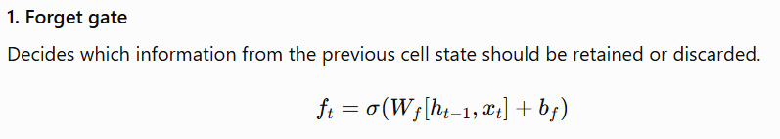
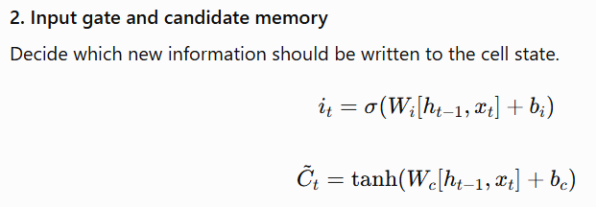
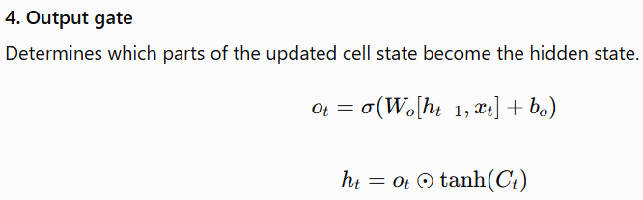
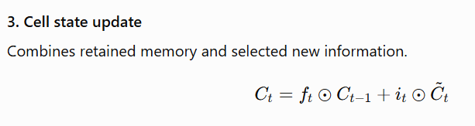
Four key components of an LSTM cell

Slide 35
Other Gated RNNs : Gated Recurrent Unit (GRU)
Architecture designed to help capture longer-term dependencies
A GRU uses two main gates:
Update gate: Controls how much of the previous state is retained versus replaced with new information.
Reset gate: Controls how much of the previous state contributes to the candidate state.
Unlike a conventional LSTM, a standard GRU has no separate cell state and combines the memory and hidden-state roles.

Slide 36
SUMMARY
Encoder–decoder maps one sequence to another;
Deep RNNs stack recurrent layers;
Recursive networks combine tree-structured representations;
LSTM and GRU use gates to regulate information and improve learning of long-term dependencies.

